Slide 1
TPRM Dashboards
Examples for TPRM Powered
Summer 2020

Slide 2
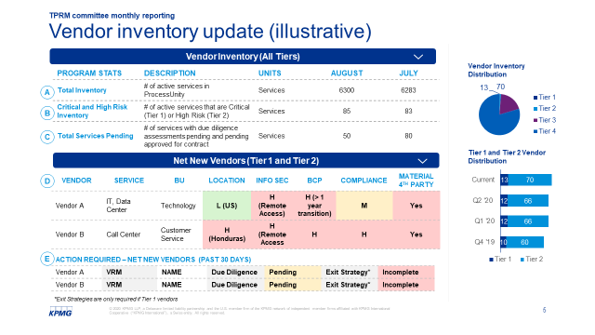
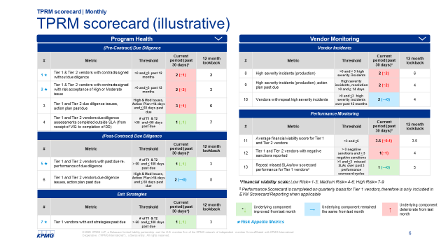
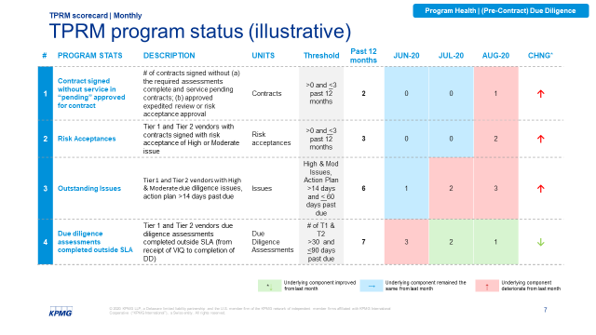
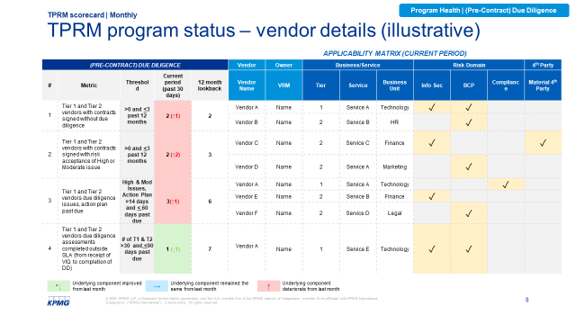
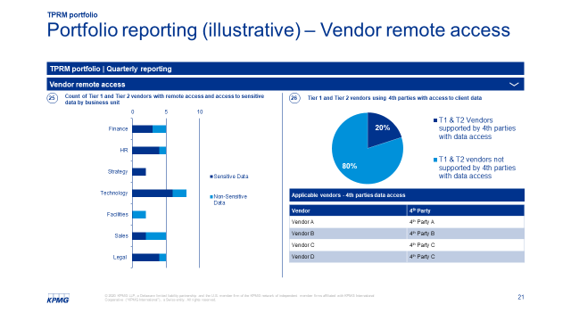
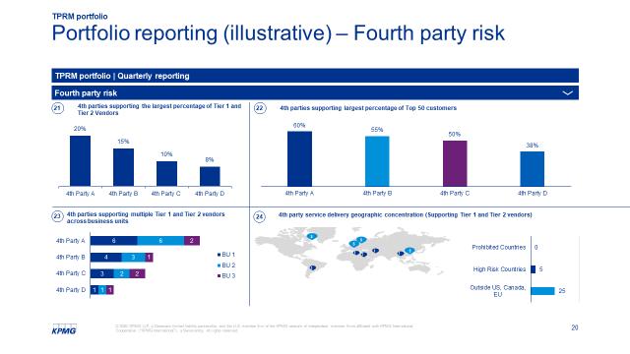
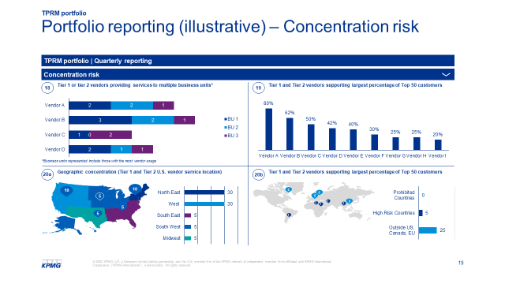
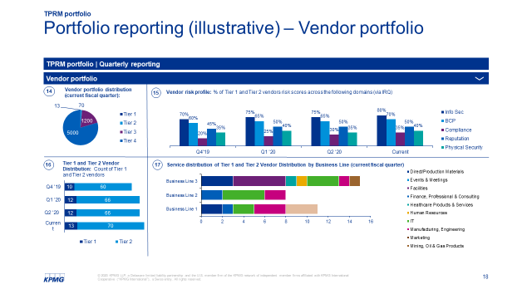
Overview – TPRM reporting
TPRM scorecard and portfolio reporting
Section Details
Key Takeaways
TPRM Scorecard, includes 13 metrics (see summary below)
1. Vendor Inventory Update, including:
Vendor inventory distribution
Newly onboarded vendors (Tier 1 and Tier 2) risk profile
TPRM Program | Vendor monitoring
(Pre-Contract) Due Diligence [4 metrics] | Vendor Incidents [3 metrics]
(Post-Contract) Due Diligence [2 metrics] | Performance Monitoring [3 metrics]
Exit Strategies [1 metric]
2. TPRM Scorecard Reporting| Monthly: Address Program Status Metrics (7) & Monitoring Metrics (6), via 3 slides:
TPRM Scorecard One-Pager: One page view of all 13 metrics
Monthly Status Update: Month-over-month trends and status against threshold for each metric
Vendor Details: Highlight specific net new vendors in reporting period (past 30 days) for each metric; highlight applicable service/ business unit, risk domains, and use of material 4th parties
3. TPRM Portfolio Reporting| Quarterly (17): Reporting to TPRM Committee on quarterly basis to provide aggregate view of risk across vendor portfolio and inform strategic decisions
Data Field Overlays | Service /Business Unit Risk Domains (Info Sec, BCP, Compliance) 4th Party
Portfolio Reporting, includes 17 metrics (see summary below)
Quarterly Portfolio Reporting | Risk Stakeholder
Vendor Portfolio [4 metrics] | All
Concentration Risk [4 metrics] | BCP, Compliance, Info Sec
Fourth Party Risk [4 metrics] | BCP. Compliance
Vendor Remote Access [3 metrics] | Info Sec
Business Continuity [1 metric] | BCP
Reg Change Management [1 metric] | TPRM

Slide 3
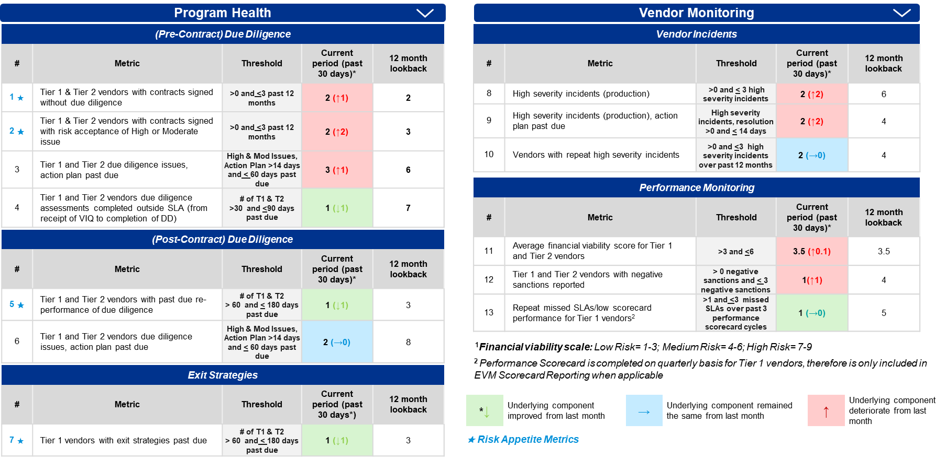
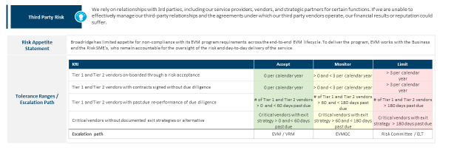
Overview – TPRM reporting (continued)
TPRM scorecard and portfolio reporting
TPRM Committee Meeting | Monthly
TPRM Committee Meeting | Quarterly
Operational Risk Oversight Committee | Quarterly
Board| Escalations & Annual Review
Objective
Report monthly to TPRM Committee on TPRM program adherence and vendor risk by monitoring for program control failures on a vendor-by-vendor basis informing tactical decision making
Report quarterly to the risk committee on TPRM Scorecard tolerance breaches, issue escalations and TPRM portfolio
Report on an ad-hoc basis to Board on significant Risk Appetite limit breaches and high risk issues
Report quarterly to the TPRMGC on aggregate risk and concentrations of the vendor portfolio to inform strategic decision making
Reporting Focus
TPRM Scorecard
TPRM Scorecard
TPRM Scorecard Metrics w/ Tolerance Breaches
Risk Appetite Escalations
+
+
+
+
Issues Identified
Issues Identified
Issues Identified
Issues Escalations
+
+
TPRM Portfolio
TPRM Portfolio

Slide 4

Overview – TPRM reporting | Monthly
TPRM scorecard & portfolio reporting
Purpose
To define key reporting metrics for monthly reporting to the TPRMGC to provide status of: (1) TPRM Program and (2) Vendor Monitoring
1. Vendor Inventory Update
2. TPRM Scorecard One-Page View
3. Monthly Status Update + Vendor Details
Inventory Status
Program Health + Vendor Monitoring Metrics
Monthly Status
Monthly Status- Status of metrics Month-to-Month; each metric includes detailed description
Vendor Inventory Status: Monthly update on vendor inventory distribution
Vendor Details
+
Net new Tier 1 and Tier 2 Vendors: Highlight newly completed IRQs for Tier 1 and Tier 2 Vendors – past 30 days (Highlight risk areas and necessary actions)
13 Scorecard Metrics: One page view of (7) program health metrics and (6) Vendor Monitoring metrics, including tracking to threshold, current reporting period, and 12 month lookback view
Vendor Details - Breakout of specific applicable vendors in reporting period, including applicable service, business unit, risk domains, 4th party

Slide 5
Vendor inventory update (illustrative)
TPRM committee monthly reporting
Vendor Inventory (All Tiers)
PROGRAM STATS | DESCRIPTION | UNITS | AUGUST | JULY
Total Inventory | # of active services in ServiceNow | Services | 6300 | 6283
Critical and High Risk Inventory | # of active services that are Critical (Tier 1) or High Risk (Tier 2) | Services | 85 | 83
Total Services Pending | # of services with due diligence assessments pending and pending approved for contract | Services | 50 | 80
Vendor Inventory Distribution
A
B
C
Net New Vendors (Tier 1 and Tier 2)
Tier 1 and Tier 2 Vendor Distribution
D
VENDOR | SERVICE | BU | LOCATION | INFO SEC | BCP | COMPLIANCE | MATERIAL 4TH PARTY
Vendor A | IT, Data Center | Technology | L (US) | H (Remote Access) | H (> 1 year transition) | M | Yes
Vendor B | Call Center | Customer Service | H (Honduras) | H (Remote Access | H | H | Yes
E
ACTION REQUIRED – NET NEW VENDORS (PAST 30 DAYS)
Vendor A | Relationship Manager | NAME | Due Diligence | Pending | Exit Strategy* | Incomplete
Vendor B | Relationship Manager | NAME | Due Diligence | Pending | Exit Strategy* | Incomplete
*Exit Strategies are only required if Tier 1 vendors

Slide 6
TPRM scorecard (illustrative)
TPRM scorecard | Monthly
Program Health
Vendor Monitoring
(Pre-Contract) Due Diligence
# | Metric | Threshold | Current period (past 30 days)* | 12 month lookback
1 ★ | Tier 1 & Tier 2 vendors with contracts signed without due diligence | >0 and <3 past 12 months | 2 (↑1) | 2
2 ★ | Tier 1 & Tier 2 vendors with contracts signed with risk acceptance of High or Moderate issue | >0 and <3 past 12 months | 2 (↑2) | 3
3 | Tier 1 and Tier 2 due diligence issues, action plan past due | High & Mod Issues, Action Plan >14 days and < 60 days past due | 3 (↑1) | 6
4 | Tier 1 and Tier 2 vendors due diligence assessments completed outside SLA (from receipt of VIQ to completion of DD) | # of T1 & T2 >30 and <90 days past due | 1 (↓1) | 7
Vendor Incidents
# | Metric | Threshold | Current period (past 30 days)* | 12 month lookback
8 | High severity incidents (production) | >0 and < 3 high severity incidents | 2 (↑2) | 6
9 | High severity incidents (production), action plan past due | High severity incidents, resolution >0 and < 14 days | 2 (↑2) | 4
10 | Vendors with repeat high severity incidents | >0 and <3 high severity incidents over past 12 months | 2 (→0) | 4
Performance Monitoring
# | Metric | Threshold | Current period (past 30 days)* | 12 month lookback
11 | Average financial viability score for Tier 1 and Tier 2 vendors | >3 and <6 | 3.5 (↑0.1) | 3.5
12 | Tier 1 and Tier 2 vendors with negative sanctions reported | > 0 negative sanctions and < 3 negative sanctions | 1(↑1) | 4
13 | Repeat missed SLAs/low scorecard performance for Tier 1 vendors² | >1 and <3 missed SLAs over past 3 performance scorecard cycles | 1 (→0) | 5
(Post-Contract) Due Diligence
# | Metric | Threshold | Current period (past 30 days)* | 12 month lookback
5 ★ | Tier 1 and Tier 2 vendors with past due re-performance of due diligence | # of T1 & T2 > 60 and < 180 days past due | 1 (↓1) | 3
6 | Tier 1 and Tier 2 vendors due diligence issues, action plan past due | High & Mod Issues, Action Plan >14 days and < 60 days past due | 2 (→0) | 8
¹Financial viability scale: Low Risk= 1-3; Medium Risk= 4-6; High Risk= 7-9
² Performance Scorecard is completed on quarterly basis for Tier 1 vendors, therefore is only included in TPRM Scorecard Reporting when applicable
Exit Strategies
# | Metric | Threshold | Current period (past 30 days*) | 12 month lookback
7 ★ | Tier 1 vendors with exit strategies past due | # of T1 & T2 > 60 and < 180 days past due | 1 (↓1) | 3
*↓ | Underlying component improved from last month | → | Underlying component remained the same from last month | ↑ | Underlying component deteriorate from last month
★ Risk Appetite Metrics

Slide 7
TPRM program status (illustrative)
Program Health | (Pre-Contract) Due Diligence
TPRM scorecard | Monthly
# | PROGRAM STATS | DESCRIPTION | UNITS | Threshold | Past 12 months | JUN-20 | JUL-20 | AUG-20 | CHNG*
1 | Contract signed without service in “pending” approved for contract | # of contracts signed without (a) the required assessments complete and service pending contracts; (b) approved expedited review or risk acceptance approval | Contracts | >0 and <3 past 12 months | 2 | 0 | 0 | 1 | ↑
2 | Risk Acceptances | Tier 1 and Tier 2 vendors with contracts signed with risk acceptance of High or Moderate issue | Risk acceptances | >0 and <3 past 12 months | 3 | 0 | 0 | 2 | ↑
3 | Outstanding Issues | Tier 1 and Tier 2 vendors with High & Moderate due diligence issues, action plan >14 days past due | Issues | High & Mod Issues, Action Plan >14 days and < 60 days past due | 6 | 1 | 2 | 3 | ↑
4 | Due diligence assessments completed outside SLA | Tier 1 and Tier 2 vendors due diligence assessments completed outside SLA (from receipt of VIQ to completion of DD) | Due Diligence Assessments | # of T1 & T2 >30 and <90 days past due | 7 | 3 | 2 | 1 | ↓
*↓ | Underlying component improved from last month | → | Underlying component remained the same from last month | ↑ | Underlying component deteriorate from last month

Slide 8
TPRM program status – vendor details (illustrative)
Program Health | (Pre-Contract) Due Diligence
TPRM scorecard | Monthly
 |  |  |  |  | APPLICABILITY MATRIX (CURRENT PERIOD)
(PRE-CONTRACT) DUE DILIGENCE |  |  |  |  | Vendor | Owner | Business/Service |  |  | Risk Domain |  |  | 4th Party
# | Metric | Threshold | Current period (past 30 days) | 12 month lookback | Vendor Name | VRM | Tier | Service | Business Unit | Info Sec | BCP | Compliance | Material 4th Party
1 | Tier 1 and Tier 2 vendors with contracts signed without due diligence | >0 and <3 past 12 months | 2 (↑1) | 2 | Vendor A | Name | 1 | Service A | Technology | ✓ | ✓
 |  |  |  |  | Vendor B | Name | 2 | Service B | HR |  | ✓
2 | Tier 1 and Tier 2 vendors with contracts signed with risk acceptance of High or Moderate issue | >0 and <3 past 12 months | 2 (↑2) | 3 | Vendor C | Name | 2 | Service C | Finance | ✓ |  |  | ✓
 |  |  |  |  | Vendor D | Name | 2 | Service A | Marketing |  | ✓
3 | Tier 1 and Tier 2 vendors due diligence issues, action plan past due | High & Mod Issues, Action Plan >14 days and < 60 days past due | 3(↑1) | 6 | Vendor A | Name | 1 | Service A | Technology |  |  | ✓
 |  |  |  |  | Vendor E | Name | 2 | Service B | Finance | ✓
 |  |  |  |  | Vendor F | Name | 2 | Service D | Legal |  | ✓
4 | Tier 1 and Tier 2 vendors due diligence assessments completed outside SLA (from receipt of VIQ to completion of DD) | # of T1 & T2 >30 and <90 days past due | 1 (↓1) | 7 | Vendor A | Name | 1 | Service E | Technology | ✓ | ✓
*↓ | Underlying component improved from last month | → | Underlying component remained the same from last month | ↑ | Underlying component deteriorate from last month

Slide 9
TPRM program status (illustrative)
Program Health | (Post-Contract) Due Diligence
TPRM scorecard | Monthly
# | PROGRAM STATS | DESCRIPTION | UNITS | Threshold | Past 12 months | JUN-20 | JUL-20 | AUG-20 | CHNG*
5 | Overdue assessments | Tier 1 and Tier 2 vendors with past due re-performance of due diligence > 60 and < 180 days past due | Due Diligence Assessments | # of T1 & T2 > 60 and < 180 days past due | 3 | 2 | 2 | 1 | ↓
6 | Outstanding Issues | Tier 1 and Tier 2 vendors with High & Moderate due diligence issues, action plan >14 and <60 days past due | Issues | High & Mod Issues, Action Plan >14 days and < 60 days past due | 8 | 2 | 2 | 2 | →
*↓ | Underlying component improved from last month | → | Underlying component remained the same from last month | ↑ | Underlying component deteriorate from last month

Slide 10
TPRM program status – vendor details (illustrative)
Program Health | (Post-Contract) Due Diligence
TPRM scorecard | Monthly
 |  |  |  |  | APPLICABILITY MATRIX (CURRENT PERIOD)
(PRE-CONTRACT) DUE DILIGENCE |  |  |  |  | Vendor | Owner | Business/Service |  |  | Risk Domain |  |  | 4th Party
# | Metric | Threshold | Current period (past 30 days) | 12 month lookback | Vendor Name | VRM | Tier | Service | Business Unit | Info Sec | BCP | Compliance | Material 4th Party
5 | Tier 1 and Tier 2 vendors with past due re-performance of due diligence | # of T1 & T2 > 60 and < 180 days past due | 1 (↓1) | 3 | Vendor A |  | 1 |  | Technology | ✓ | ✓
6 | Tier 1 and Tier 2 vendors due diligence issues, action plan past due | High & Mod Issues, Action Plan >14 and < 60 days past due | 2 (→0) | 6 |  |  |  |  |  | ✓
 |  |  |  |  | Vendor C |  | 2 |  | Finance |  | ✓
*↓ | Underlying component improved from last month | → | Underlying component remained the same from last month | ↑ | Underlying component deteriorate from last month

Slide 11
TPRM program status (illustrative)
Program Health | Exit Strategies
TPRM scorecard | Monthly
# | PROGRAM STATS | DESCRIPTION | UNITS | Threshold | Past 12 months | JUN-20 | JUL-20 | AUG-20 | CHNG*
7 | Exit Strategies | Tier 1 vendors with exit strategies past due | Services | T1 exit strategy > 60 and < 180 days past due | 3 | 2 | 2 | 1 | ↓
*↓ | Underlying component improved from last month | → | Underlying component remained the same from last month | ↑ | Underlying component deteriorate from last month

Slide 12
TPRM program status – vendor details (illustrative)
Program Health | Exit Strategies
TPRM scorecard | Monthly
 |  |  |  |  | APPLICABILITY MATRIX (CURRENT PERIOD)
(PRE-CONTRACT) DUE DILIGENCE |  |  |  |  | Vendor | Owner | Business/Service |  |  | Risk Domain |  |  | 4th Party
# | Metric | Threshold | Current period (past 30 days) | 12 month lookback | Vendor Name | VRM | Tier | Service | Business Unit | Info Sec | BCP | Compliance | Material 4th Party
7 | Tier 1 vendors with exit strategies past due | T1 exit strategy > 60 and < 180 days past due | 1 (↓1) | 3 | Vendor A |  | 1 |  | Technology | ✓ | ✓ |  | ✓
*↓ | Underlying component improved from last month | → | Underlying component remained the same from last month | ↑ | Underlying component deteriorate from last month

Slide 13
TPRM program status (illustrative)
Vendor Monitoring | Incidents
TPRM scorecard | Monthly
# | PROGRAM STATS | DESCRIPTION | UNITS | Threshold | Past 12 months | JUN-20 | JUL-20 | AUG-20 | CHNG*
8 | Vendor Incidents | Count of high severity incidents (production) | Incidents | >0 and < 3 high severity incidents | 6 | 0 | 0 | 2 | ↑
9 | Vendor Incidents, Past due action plans | High severity incidents (production), action plan past due | Action Plans | High severity incidents, resolution >0 and < 14 days | 4 | 0 | 0 | 2 | ↑
10 | Repeat incidents | Vendors with repeat high severity incidents | Vendors | >0 and <3 high severity incidents over past 12 months | 4 | 1 | 1 | 1 | →
*↓ | Underlying component improved from last month | → | Underlying component remained the same from last month | ↑ | Underlying component deteriorate from last month

Slide 14
TPRM program status – vendor details (illustrative)
Vendor Monitoring | Incidents
TPRM scorecard | Monthly
 |  |  |  |  | APPLICABILITY MATRIX (CURRENT PERIOD)
(PRE-CONTRACT) DUE DILIGENCE |  |  |  |  | Vendor | Owner | Business/Service |  |  | Risk Domain |  |  | 4th Party
# | Metric | Threshold | Current period (past 30 days) | 12 month lookback | Vendor Name | VRM | Tier | Service | Business Unit | Info Sec | BCP | Compliance | Material 4th Party
8 | Count of high severity incidents (production) | >0 and < 3 high severity incidents | 2 (↑2) | 6 | Vendor A |  | 1 |  | Technology | ✓ |  |  | ✓
 |  |  |  |  | Vendor B |  | 2 |  | HR |  | ✓
9 | High severity incidents (production), action plan past due | High severity incidents, resolution >0 and < 14 days | 2 (↑2) | 4 | Vendor D |  | 2 |  | Finance | ✓ |  |  | ✓
 |  |  |  |  | Vendor E |  | 2 |  | Marketing |  | ✓
10 | Vendors with repeat high severity incidents | >0 and <3 high risk incidents over past 12 months | 2 (→0) | 4 | Vendor F |  | 2 |  | Legal | ✓
*↓ | Underlying component improved from last month | → | Underlying component remained the same from last month | ↑ | Underlying component deteriorate from last month

Slide 15
TPRM program status (illustrative)
Vendor Monitoring | Performance Monitoring
TPRM scorecard | Monthly
# | PROGRAM STATS | DESCRIPTION | UNITS | Threshold | Past 12 months | JUN-20 | JUL-20 | AUG-20 | CHNG*
11 | Financial Viability | Average financial viability score for Tier 1 and Tier 2 vendors | FVRR Score | >3 and <6¹ | 3.5 | 3.4 | 3.4 | 3.5 | ↑
12 | Negative Sanctions | Tier 1 and Tier 2 vendors with negative sanctions reported | Services | > 0 negative sanctions and < 3 negative sanctions | 4 | 0 | 0 | 1 | ↑
13 | Missed SLAs | Repeat missed SLAs/low scorecard performance for Tier 1 vendors² | Vendors | >1 and <3 missed SLAs over past 3 performance scorecard cycles | 5 | 2 | 1 | 1 | →
*↓ | Underlying component improved from last month | → | Underlying component remained the same from last month | ↑ | Underlying component deteriorate from last month

Slide 16
TPRM program status – vendor details (illustrative)
Vendor Monitoring | Performance Monit
TPRM scorecard | Monthly
 |  |  |  |  | APPLICABILITY MATRIX (CURRENT PERIOD)
(PRE-CONTRACT) DUE DILIGENCE |  |  |  |  | Vendor | Owner | Business/Service |  |  | Risk Domain |  |  | 4th Party
# | Metric | Threshold | Current period (past 30 days) | 12 month lookback | Vendor Name | VRM | Tier | Service | Business Unit | Info Sec | BCP | Compliance | Material 4th Party
11 | Average financial viability score for Tier 1 and Tier 2 vendors | >3 and <6¹ | 3.5(↑0.1) | 3.4 | Vendor A |  | 1 |  | Technology |  | ✓
12 | Tier 1 and Tier 2 vendors with negative sanctions reported | > 0 negative sanctions and < 3 negative sanctions | 1(↑1) | 4 | Vendor D |  | 2 |  | Finance |  |  | ✓
13 | Repeat missed SLAs/low scorecard performance for Tier 1 vendors² | >1 and <3 missed SLAs over past 3 performance scorecard cycles | 1 (→0) | 5 | Vendor F |  | 2 |  | Legal | ✓
*↓ | Underlying component improved from last month | → | Underlying component remained the same from last month | ↑ | Underlying component deteriorate from last month

Slide 17
TPRM portfolio | Quarterly
TPRM reporting

Slide 18
Portfolio reporting (illustrative) – Vendor portfolio
TPRM portfolio
TPRM portfolio | Quarterly reporting
Vendor portfolio
14
Vendor portfolio distribution (current fiscal quarter):
15
Vendor risk profile: % of Tier 1 and Tier 2 vendors risk scores across the following domains (via IRQ)
16
Tier 1 and Tier 2 Vendor Distribution: Count of Tier 1 and Tier 2 vendors
17
Service distribution of Tier 1 and Tier 2 Vendor Distribution by Business Line (current fiscal quarter)

Slide 19
Portfolio reporting (illustrative) – Concentration risk
TPRM portfolio
TPRM portfolio | Quarterly reporting
Concentration risk
18
Tier 1 or tier 2 vendors providing services to multiple business units*
19
Tier 1 and Tier 2 vendors supporting largest percentage of Top 50 customers
*Business units represented include those with the most vendor usage
20a
Geographic concentration (Tier 1 and Tier 2 U.S. vendor service location)
20b
Tier 1 and Tier 2 vendors supporting largest percentage of Top 50 customers
10
10
5
5
5
5
5
5
1
1
1
1
5
1

Slide 20
Portfolio reporting (illustrative) – Fourth party risk
TPRM portfolio
TPRM portfolio | Quarterly reporting
Fourth party risk
21
22
4th parties supporting the largest percentage of Tier 1 and
Tier 2 Vendors
4th parties supporting largest percentage of Top 50 customers
23
4th parties supporting multiple Tier 1 and Tier 2 vendors across business units
24
4th party service delivery geographic concentration (Supporting Tier 1 and Tier 2 vendors)
5
5
5
1
5
1
1
1
1

Slide 21
Portfolio reporting (illustrative) – Vendor remote access
TPRM portfolio
TPRM portfolio | Quarterly reporting
Vendor remote access
25
Count of Tier 1 and Tier 2 vendors with remote access and access to sensitive data by business unit
26
Tier 1 and Tier 2 vendors using 4th parties with access to client data
Applicable vendors - 4th parties data access
Vendor | 4th Party
Vendor A | 4th Party A
Vendor B | 4th Party B
Vendor C | 4th Party C
Vendor D | 4th Party C

Slide 22
Portfolio reporting (illustrative) – Vendor remote access
TPRM portfolio
TPRM portfolio | Quarterly reporting
Vendor remote access
27
Count of Tier 1 and Tier 2 vendors outside U.S. with sensitive data

Slide 23
Portfolio reporting (Illustrative) – Business continuity
TPRM portfolio
TPRM portfolio | Quarterly reporting
Business continuity
28
Tier 1 or Tier 2 third parties without alternative or>1 year transition time
No Alternative – Applicable Vendors
>1 year Transition – Applicable Vendors
Vendor
Vendor A
Vendor B
Vendor C
Vendor
Vendor A
Vendor D
Vendor E
Vendor F

Slide 24
Thank you

Slide 25
Some or all of the services described herein may not be permissible for KPMG audit clients and their affiliates or related entities.
kpmg.com/socialmedia
The information contained herein is of a general nature and is not intended to address the circumstances of any particular individual or entity. Although we endeavor to provide accurate and timely information, there can be no guarantee that such information is accurate as of the date it is received or that it will continue to be accurate in the future. No one should act upon such information without appropriate professional advice after a thorough examination of the particular situation.
© 2020 KPMG LLP, a Delaware limited liability partnership and the U.S. member firm of the KPMG network of independent member firms affiliated with KPMG International Cooperative (“KPMG International”), a Swiss entity.
All rights reserved.
The KPMG name and logo are registered trademarks or trademarks of KPMG International.

